Slide 1
XML is your friend
Bartosz Bielawski

Slide 2
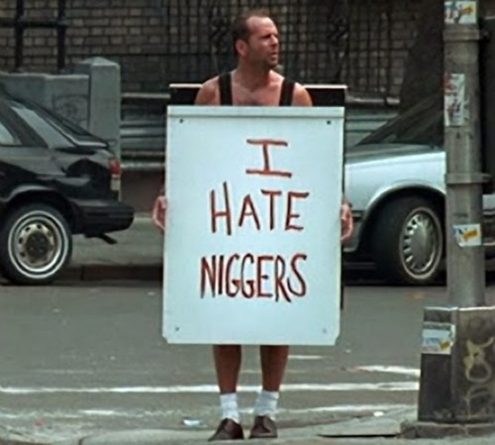
XML is… wha?

Slide 3
Agenda
Why XML?
Demo, demo, demo...
Summary and Q&A

Slide 4
Demo plan
Implicit foreach
Select-Xml - simple
Select-Xml - namespaces
XML applied

Slide 5
Summary
Ignorance fuels fear
Cmdlet make your life easier
Understand schema, be productive

Slide 6
Questions?

Slide 7
Get-OptiverInfo
Hiring
Smart people
Interesting projects
Mix of Dev and Ops
No-Corp ;)

Slide 8
Next Steps...
Now: 15 min break
Grab a coffee
Stay here to enjoy next presentation
Change track and switch to another room
Ask me questions or meet me in a breakout session room afterwards

